Slide 1
Chapter 3: Everything Generates Data
Vịnh Nguyễn
Introduction to the Internet of Things v2.0
Notes:
Cisco Networking Academy Program
Introduction to the Internet of Things v2.0
Chapter 3: Everything Generates Data

Slide 2
Instructor Materials – Chapter 3 Planning Guide
This PowerPoint deck is divided in two parts:
Instructor Planning Guide
Information to help you become familiar with the chapter
Teaching aids
Instructor Class Presentation
Optional slides that you can use in the classroom
Begins on slide # 9
Note: Remove the Planning Guide from this presentation before sharing with anyone.
Notes:
2

Slide 3
Chapter 3: Everything Generates Data
Introduction to the Internet of Things v2.0 Planning Guide
Notes:
Cisco Networking Academy Program
Introduction to the Internet of Things
Chapter 3: Everything Generates Data

Slide 4
Chapter 3: Activities
What activities are associated with this chapter?
Page # | Activity Type | Activity Name
3.1.1.1 | Video | How San Diego’s Metropolitan Transit System uses Big Data
3.1.1.2 | Activity | Does the Business have Big Data?
3.1.1.3 | Activity | Volume/Velocity/Variety
3.1.1.5 | Lab | Explore a large dataset
3.1.1.6 | Activity | Topic Assessment
3.1.2.5 | Activity | Topic Assessment
3.1.3.5 | Activity | Explore Analyzed Data
3.1.3.7 | Lab | Using Excel to Forecast
3.1.3.8 | Activity | Topic Assessment
Notes:
4

Slide 5
Chapter 3: Assessment
Students should complete Chapter 3, “Assessment” after completing Chapter 3.
Quizzes, labs, topic assessments and other activities can be used to informally assess student progress.
Notes:
5

Slide 6
Chapter 1: Best Practices
Prior to teaching Chapter 3, the instructor should:
Complete Chapter 3 Quiz
Preview the labs, videos and activities.
Notes:
6

Slide 7
Chapter 3: Additional Help
For additional help with teaching strategies, including lesson plans, analogies for difficult concepts, and discussion topics, visit the Community Forums .
If you have lesson plans or resources that you would like to share, upload them to the Community Forums in order to help other instructors.
Students can enroll in Introduction to Packet Tracer (self-paced).
Notes:
7

Slide 9
Chapter 3: Everything Generates Data
Introduction to the Internet of Things v2.0
Notes:
Cisco Networking Academy Program
Introduction to the Internet of Things
Chapter 3: Everything Generates Data

Slide 10
Chapter 3 - Sections & Objectives
3.1 Big Data
Explain the concept of Big Data.
Describe the sources of Big Data.
Explain the challenges and solutions to Big Data storage.
Explain how Big Data analytics are used to support Business.
Notes:
10
Cisco Networking Academy Program
Introduction to the Internet of Things
Chapter 1: Everything is Connected

Slide 11
3.1 Big Data
Notes:
3 – Everything Generates Data
3.1 – Big Data

Slide 12
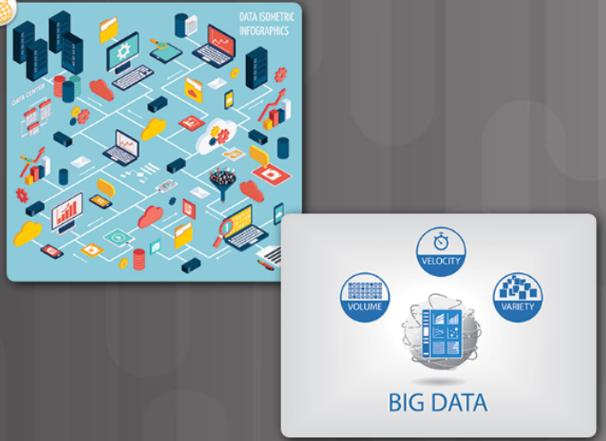
What is Big Data? What is Big Data?
Data is information that comes from a variety of sources, such as people, pictures, text, sensors, web sites and technology devices.
Three characteristics that indicate an organization may be dealing with Big Data:
A large amount of data that increasingly requires more storage space (volume).
An amount of data that is growing exponentially fast (velocity).
Data that is generated in different formats (variety).
Examples of data amounts collected by sensors:
One autonomous car can generate 4,000 gigabits (Gb) of data per day.
One smart connected home can produce as much as 1 gigabyte (GB) of information a week.
Notes:
3.1 – Big Data
3.1.1 – What is Big Data?
3.1.1.1 – What is Big Data?

Slide 13
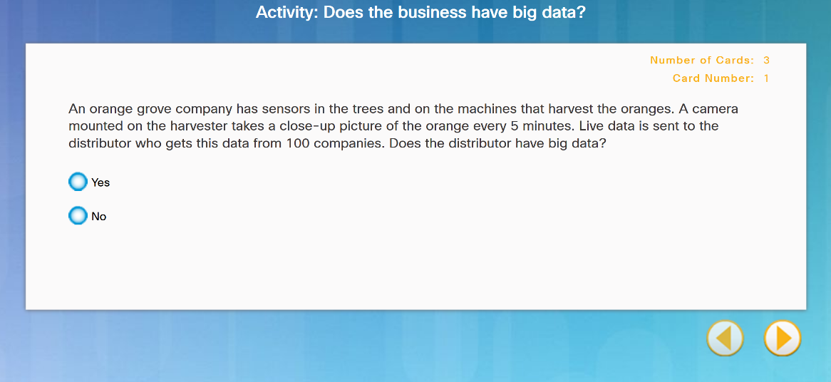
What is Big Data? Does the Business Generate Big Data?
Notes:
3.1 – Big Data
3.1.1 – What is Big Data?
3.1.1.2 – Does the Business Generate Big Data?
3.1.1.3 Activity Volume/Velocity/Variety

Slide 14
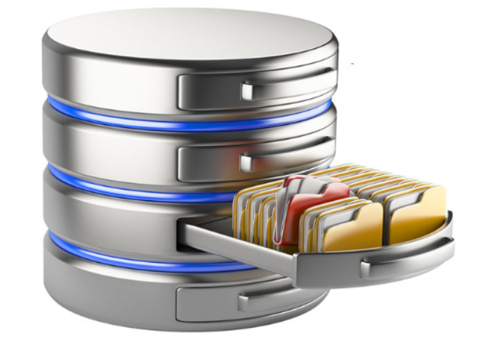
What is Big Data? Large Datasets
Companies do not necessarily have to generate their own Big Data.
There are sources of free data sets available, ready to be used and analyzed.
Notes:
3.1 – Big Data
3.1.1 – What is Big Data?
3.1.1.4 – Large Datasets

Slide 15
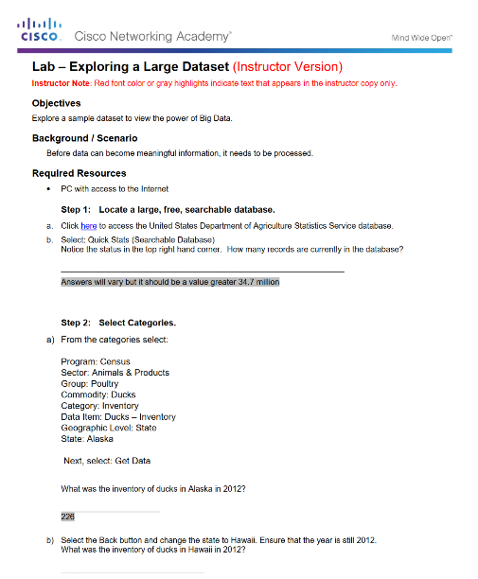
What is Big Data? Lab – Database Search
Notes:
3.1 – Big Data
3.1.1 – What is Big Data?
3.1.1.5 – Lab – Explore a Large Dataset
3.1.1.6 - Topic Assessment

Slide 16
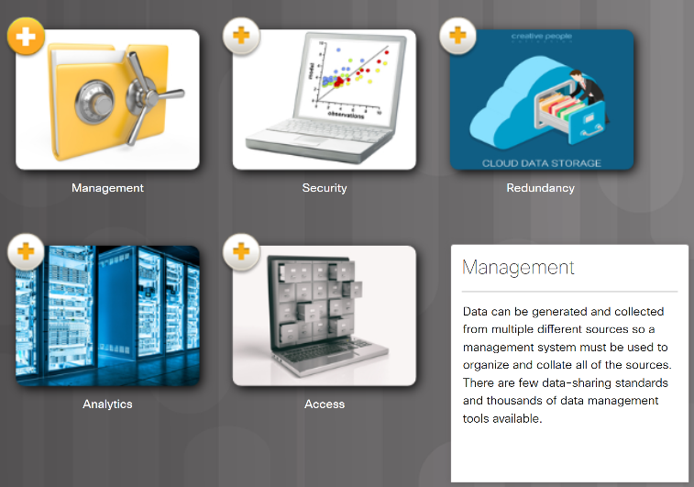
Where is Big Data Stored? What are the Challenges of Big Data?
IBM’s Big Data estimates conclude that “each day we create 2.5 quintillion bytes of data”.
Five major storage problems with Big Data:
Management
Security
Redundancy
Analytics
Access
Notes:
3.1 – Big Data
3.1.2 – Where is Big Data Stored?
3.1.2.1 – What are the Challenges of Big Data?

Slide 17
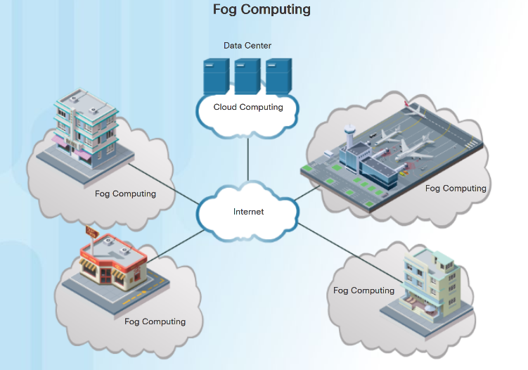
Where is Big Data Stored? Where Can We Store Big Data?
Big data is typically stored on multiple servers, in data centers.
Fog computing utilizes end-user clients or “edge” devices to do a substantial amount of the pre-processing and storage.
Data from that pre-processed analysis can be fed back into the companies’ systems to modify processes if required.
Communications to and from the servers and devices is quicker and requires less bandwidth than constantly going out to the cloud.
Notes:
3.1 – Big Data
3.1.2 – Where is Big Data Stored?
3.1.2.2 – Where Can We Store Big Data?

Slide 18

Where is Big Data Stored? The Cloud and Cloud Computing
The cloud is a collection of data centers or groups of connected servers.
Cloud services for individuals include:
Storage of data, such as pictures, music, movies, and emails.
Access many applications instead of downloading onto local device.
Access data and applications anywhere, anytime, and on any device.
Cloud Services for an Enterprise include:
Access to organizational data anywhere and at any time.
Streamlines the IT operations of an organization.
Eliminates or reduces the need for onsite IT equipment, maintenance, and management.
Reduces cost for equipment, energy, physical plant requirements, and personnel training needs.
Notes:
3.1 – Big Data
3.1.2 – Where is Big Data Stored?
3.1.2.3 – The Cloud and Cloud Computing

Slide 19
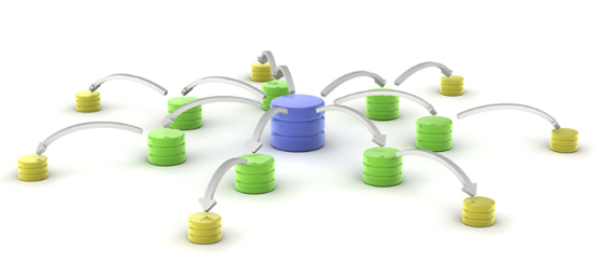
Where is Big Data Stored? Distributed Processing
Distributed data processing takes the large volume of data and breaks it into smaller pieces.
These smaller pieces are distributed in many locations to be processed by many computers.
Each computer in the distributed architecture analyzes its part of the Big Data picture (horizontal scaling).
Hadoop was created to deal with these Big Data volumes. It has two main features that has made it the industry standard:
Scalability - Larger cluster sizes improve performance and provide higher data processing capabilities.
Fault tolerance – Hadoop automatically replicates data across clusters.
Notes:
3.1 – Big Data
3.1.2 – Where is Big Data Stored?
3.1.2.4 – Distributed Processing
3.1.2.5 - Topic Assessment

Slide 20

Supporting Business with Big Data Why Do Businesses Analyze Data?
Data analytics allows businesses to better understand the impact of their products and services, adjust their methods and goals, and provide their customers with better products faster.
Value comes from two primary types of processed data, transactional and analytical.
Transactional information is captured and processed as events happen.
Used to analyze daily sales reports and production schedules to determine how much inventory to carry.
Analytical information supports managerial analysis tasks like determining whether the organization should build a new manufacturing plant.
Notes:
3.1 – Big Data
3.1.3 – Supporting Business with Big Data
3.1.3.1 – Why Do Businesses Analyze Data?

Slide 21
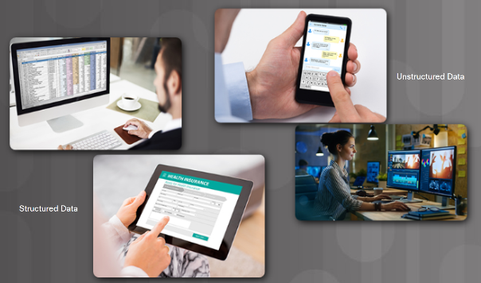
Supporting Business with Big Data Sources of Information
Data originates from sensors and anything that has been scanned, entered, and released to the Internet.
Collected data can be categorized as structured or unstructured.
Structured data is created by applications that use “fixed” format input such as spreadsheets. May need to be manipulated into a common format such as CSV.
Unstructured data is generated in a “freeform” style such as audio, video, web pages, and tweets.
Examples of tools to prepare unstructured data for processing are:
“Web scraping” tools automatically extract data from HTML pages.
RESTful application program interfaces (APIs).
Notes:
3.1 – Big Data
3.1.3 – Supporting Business with Big Data
3.1.3.2 – Sources of Information

Slide 22

Supporting Business with Big Data Data Visualization
Data mining is the process of turning raw data into meaningful information.
The mined data must be analyzed and presented to managers and decision makers.
Determining the best visualization tools to use will vary based on the following:
Number of variables
Number of data points in each variable
Is the data representing a timeline
Items require comparisons
Popular charts include line, column, bar, pie, and scatter.
Notes:
3.1 – Big Data
3.1.3 – Supporting Business with Big Data
3.1.3.3 – Data Visualization

Slide 23
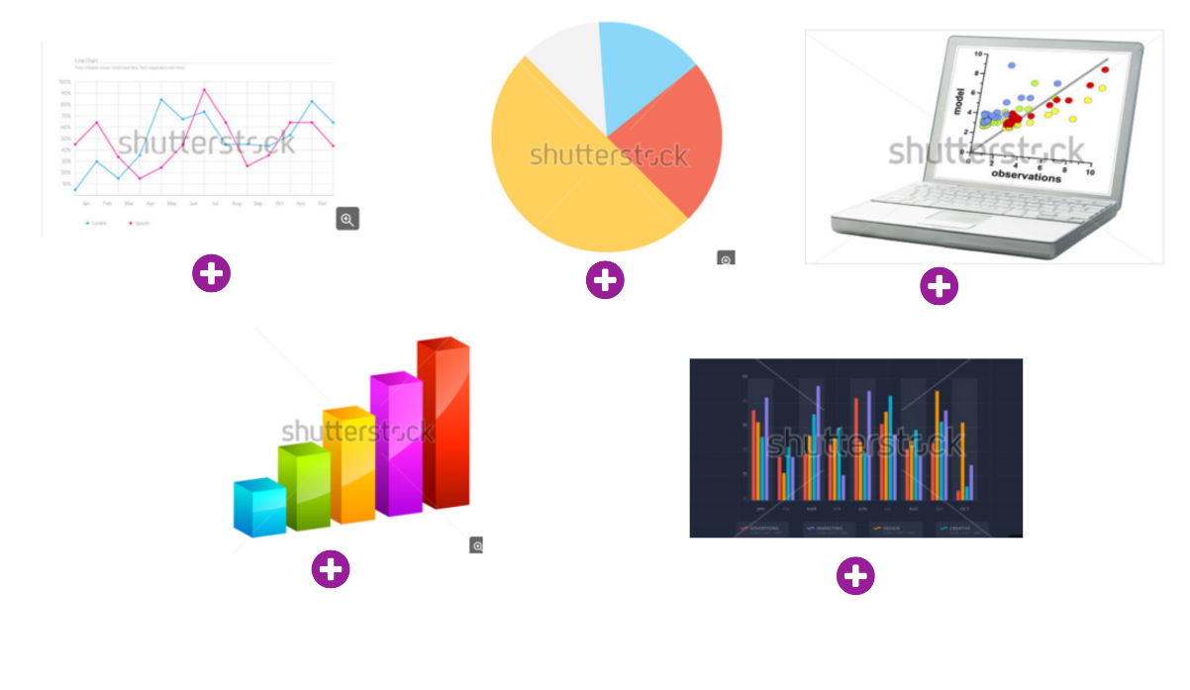
Supporting Business with Big Data Chart Types
Notes:
3.1 – Big Data
3.1.3 – Supporting Business with Big Data
3.1.3.4 – Chart Types
3.1.3.5 – Activity – Explore Analyzed Data

Slide 24
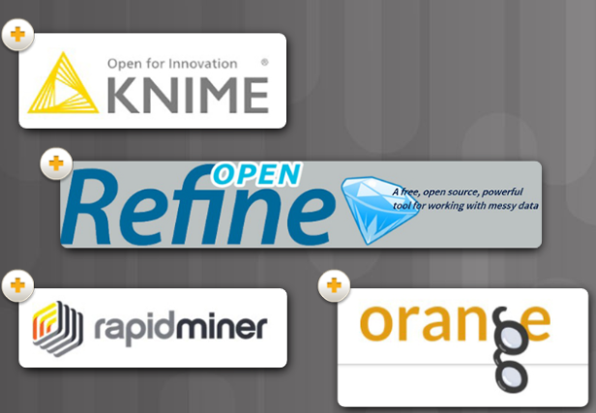
Supporting Business with Big Data Analyzing Big Data for Effective Use in Business
Data analysis is the process of inspecting, cleaning, transforming, and modeling data to uncover useful information.
Having a strategy helps a business determine the type of analysis required and the best tool to do the analysis.
Tools and applications range from using an Excel spreadsheet or Google Analytics for small to medium data samples, to the applications dedicated to manipulating and analyzing really big datasets.
Examples include Knime, OpenRefine, Orange, and RapidMiner.
Notes:
3.1 – Big Data
3.1.3 – Supporting Business with Big Data
3.1.3.6 – Analyzing Big Data for Effective Use in Business

Slide 25
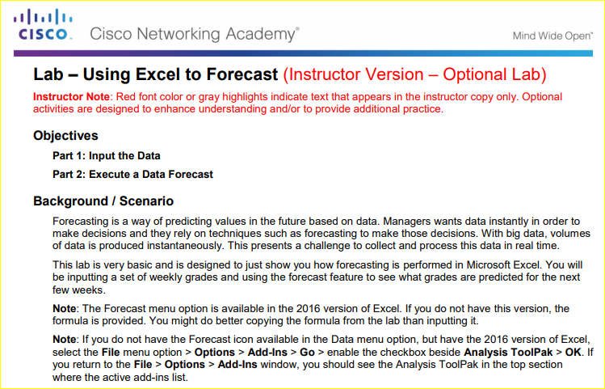
Supporting Business with Big Data Excel lab: Forecasting
Notes:
3.1 – Big Data
3.1.3 – Supporting Business with Big Data
3.1.3.7 – Lab – Using Excel to Forecast
3.1.3.8 – Topic Assessment

Slide 26
3.2 Chapter Summary
Notes:
3 – Everything Generates Data
3.2 - Summary

Slide 27
Chapter Summary Summary
Three characteristics of Big Data:
large amount of data that increasingly requires more storage space (volume)
growing exponentially fast (velocity)
generated in different formats (variety)
Fog computing utilizes end-user clients or “edge” devices to do pre-processing and storage.
Designed to keep the data closer to the source for pre-processing.
The cloud is a collection of data centers or groups of connected servers giving anywhere, anytime access to software, storage, and services using a browser interface.
Provide increased data storage and reduce the need for onsite IT equipment, maintenance, and management.
Distributed data processing takes large volumes of data from a source and breaks it into smaller pieces and distributes to many locations to be processed.
Each computer in the distributed architecture analyzes its part of the Big Data picture.
Notes:
3 – Everything Generates Data
3.2 – Summary

Slide 28
Chapter Summary Summary (Cont.)
Businesses gain value by collecting and analyzing data to understand the impact of their products and services, adjust their methods and goals, and provide their customers with better products faster.
Structured data is created by applications that use “fixed” format input such as spreadsheets or medical forms.
Unstructured data is generated in a “freeform” style such as audio, video, web pages, and tweets.
Both forms of data need to be manipulated into a common format to be analyzed.
Data mining is the process of turning raw data into meaningful information by discovering patterns and relationships in large data sets.
Data visualization is the process of taking the analyzed data and using charts such as line, column, bar, pie, or scatter to present meaningful information.
Notes:
3 – Everything Generates Data
3.2 – Summary

